Slide 1
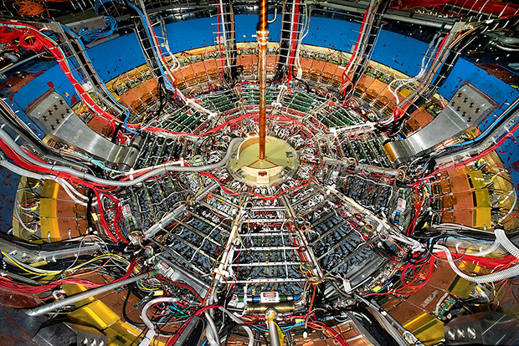
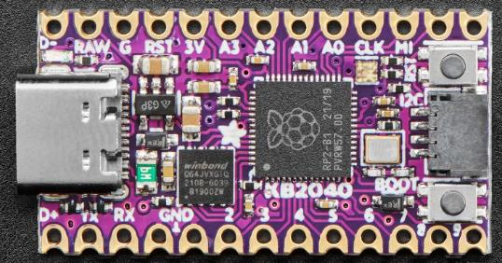
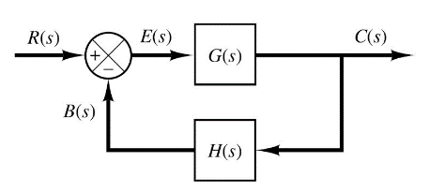

Control Systems
Engineering
(CSE 201)
Student #1
Student #2
Student #3
Team 08
RLC Resonance
Inductors & Impedance

Slide 2
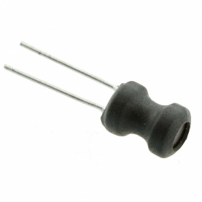
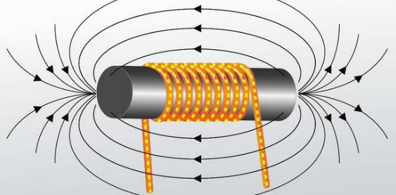

Our Challenge: Model an Inductor Circuit
An inductor is a passive two-terminal electrical component that stores energy in a magnetic field when electric current flows through it. An inductor typically consists of an insulated wire wound into a coil
When the current flowing through the coil changes, the time-varying magnetic field induces a voltage which opposes the change in current that created it. As a result, inductors oppose any changes in current passing through them

Slide 3
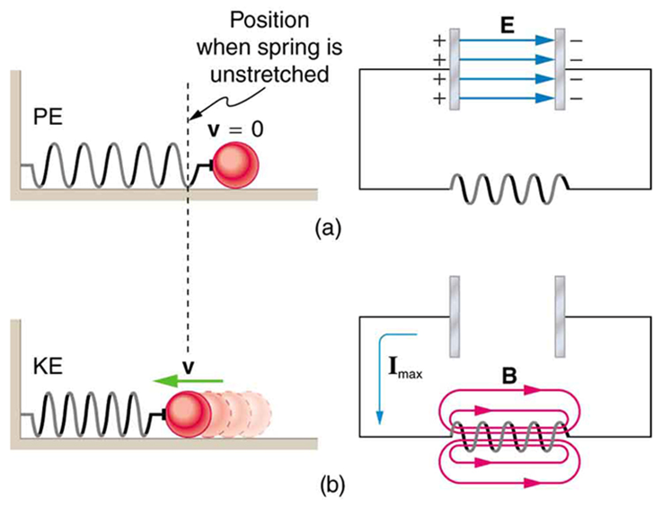
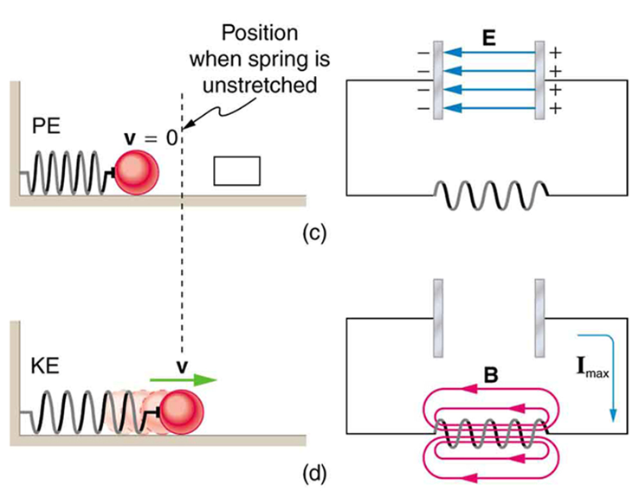
An Analog to Simple Harmonic Motion
An inductor can store electrical energy in its magnetic field, so when the circuit needs power, an inductor can draw energy from its stored magnetic field to quickly resupply the circuit

Slide 4
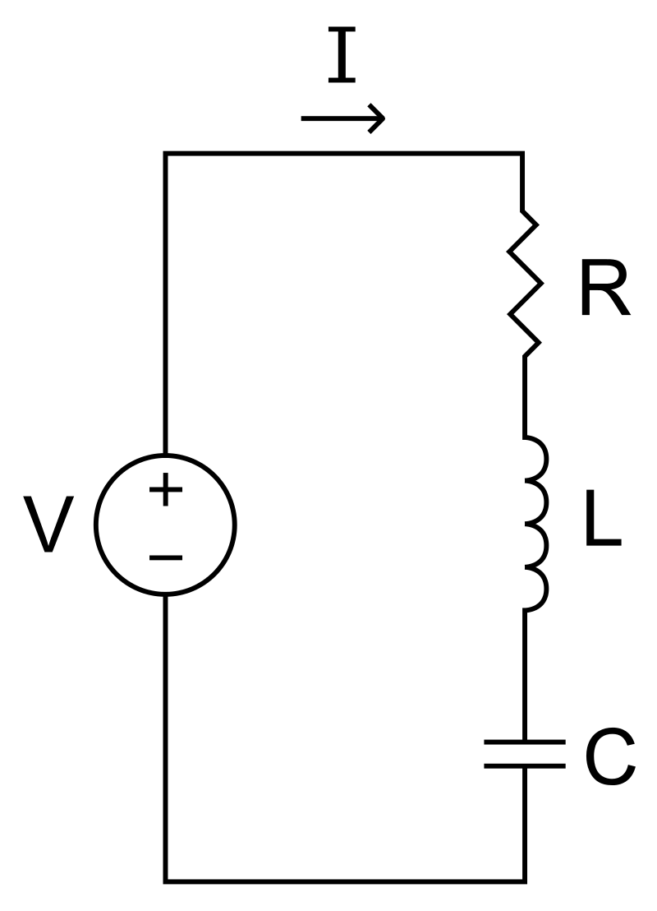

Modeling an RLC Circuit
Our challenge was to plot the current over time flowing through an RLC circuit that maintains a constant DC voltage
We used the Euler-Cromer method to estimate this 2nd-order homogenous ODE for one second using the given component values
The circuit started with one amp of current, but due to heat loss in the resistor, the energy in the circuit decayed from its initial maximum value
$$\frac{d^{2}I}{{dt}^{2}}=−\frac{R}{L}\frac{dI}{dt}−\frac{1}{LC}I$$
R = 0.1 Ohms
L = 0.01 Henries
C = 0.01 Farads
Initial I = 1 Amp

Slide 5
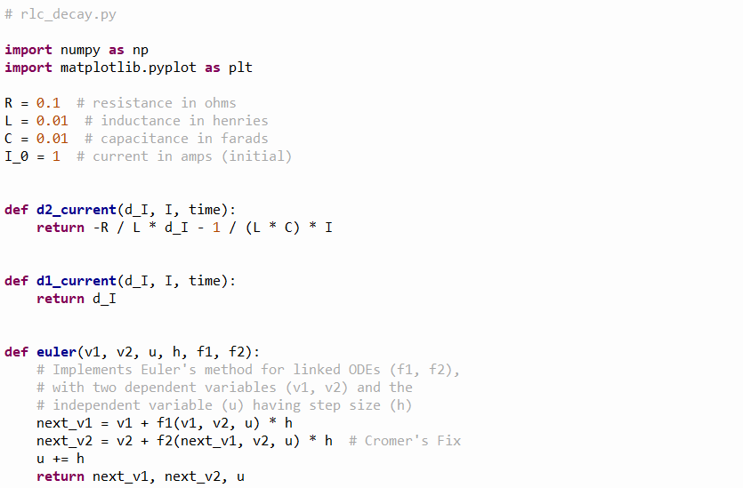
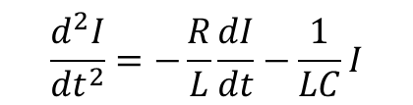


Our Solution
$$\frac{d^{2}I}{{dt}^{2}}=−\frac{R}{L}\frac{dI}{dt}−\frac{1}{LC}I$$
①
②
$$\frac{d\left(dI\right)}{dt}=−\frac{R}{L}\frac{dI}{dt}−\frac{1}{LC}I$$
③
④
$$\frac{dI}{dt}=dI$$
⑤
⑥
Rewrite 2nd-order ODE as two linked 1st-order ODEs
⑦

Slide 6
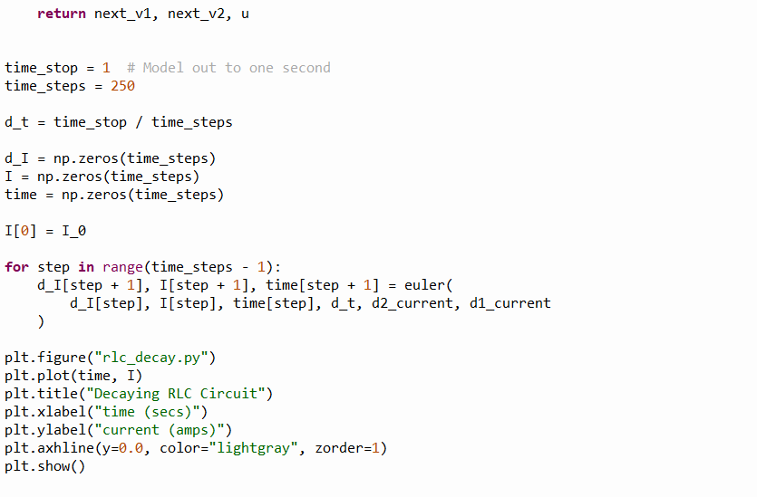
Our Solution
①
②
③
④
⑤
⑥
⑦

Slide 7
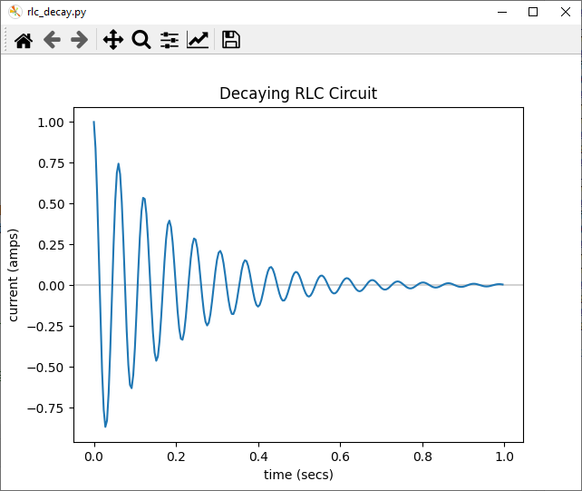
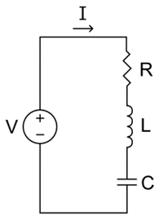
Our Results
Lacking additional energy, the circuit's power drains away as it transforms into heat within the resistor.

Slide 8
Our Results
Every RLC circuit has a specific fixed fundamental frequency in which it oscillates based on its
L and C values

Slide 9
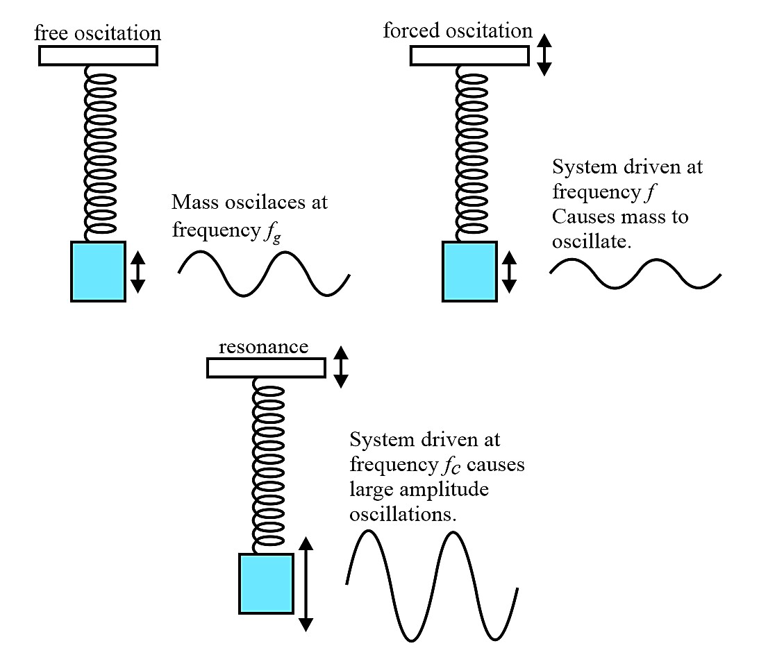
Driven Physical Oscillators - Resonance
A system driven at its resonant frequency will experience maximum amplitude

Slide 10
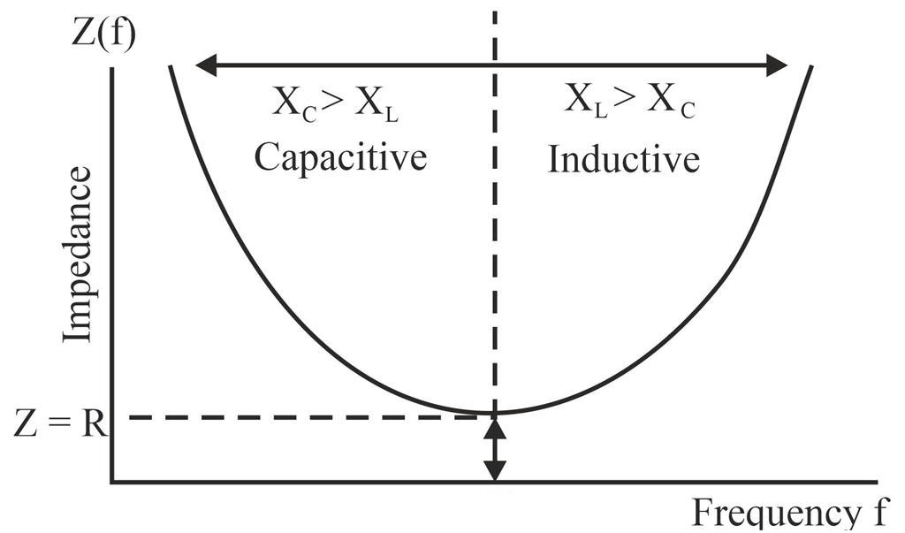



Driven Electrical Oscillators - Resonance
At the resonant frequency, the capacitive reactance in the LC components equals the inductive reactance, and therefore their impedance drops to zero – all that remains is the resistance of the R, L, C components
0
$$Z=\sqrt{R^{2}+{\left(X_{L}−X_{C}\right)}^{2}}$$
$$Z=R$$
$$X_{c}=X_{L}$$

Slide 11
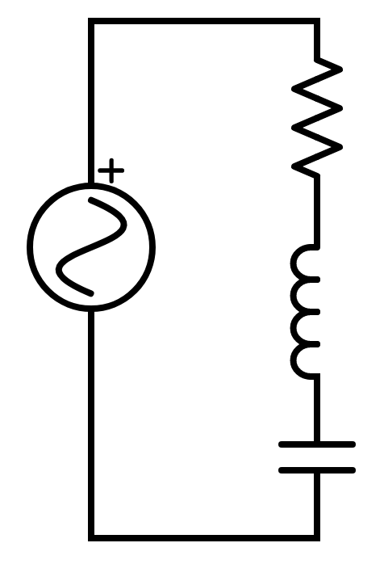

















Modeling a Driven RLC Circuit
$$ε=EMF=+1.21V$$
$$V_{s}=ε\sin\left(ωt\right)$$
AC Voltage Source
$$V_{R}=IR$$
Ohm's Law
Voltage across the resistor
10.05Ω 99.32Ω
R
$$V_{L}=L\frac{ⅆI}{ⅆt}$$
Faraday's Law
S
$$V_{C}=\frac{Q}{C}$$
Gauss's Law
100.8mH
L
$$V_{s}=V_{R}+V_{L}+V_{C}$$
Kirchhoff's Voltage Law
91.2
uF
C
Euler's Method
$$V_{s}=IR+L\frac{ⅆI}{ⅆt}+\frac{Q}{C}$$
$$Q_{n+1}=Q_{n}+I_{n}ⅆt$$
$Q=$ Charge (in Coulombs)
$$V_{s}=IR+Lα+\frac{Q}{C}$$
$$I_{n+1}=I_{n}+αⅆt$$
$I=$ Current (in Amps)
$$V_{n+1}=V_{n}+IR$$
$$\frac{ⅆQ}{ⅆt}=I$$
$$\frac{ⅆI}{ⅆt}=α$$
$$α=\frac{\left(V_{s}−IR−Q/C\right)}{L}$$
$$t_{n+1}=t_{n}+ⅆt$$

Slide 12
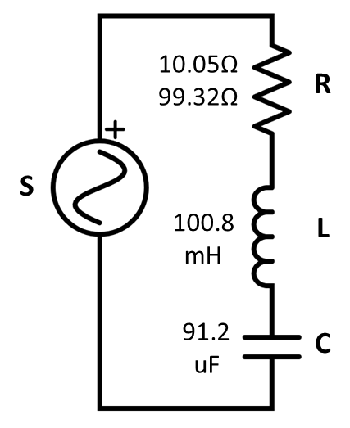
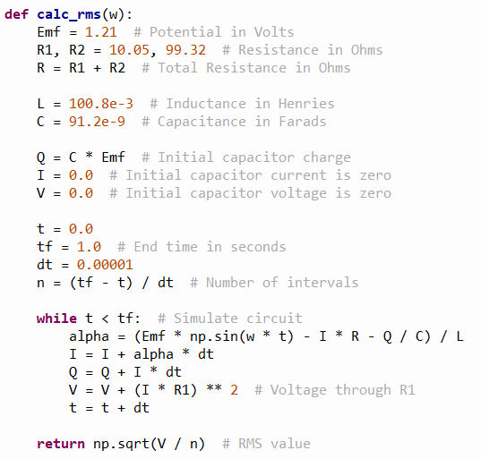
Our Revised Solution
①
②
③
④
⑤
⑥
⑦
⑧
⑨
⑩

Slide 13
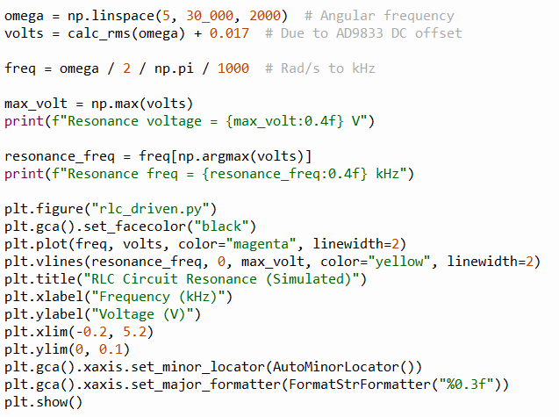


Our Revised Solution
$$5 Hz≤ω≤30 kHz$$
①
②
③
$$ω=2πf$$
$$1Hz=1000 kHz$$
④
⑤
⑥
⑦
⑧
⑨

Slide 14
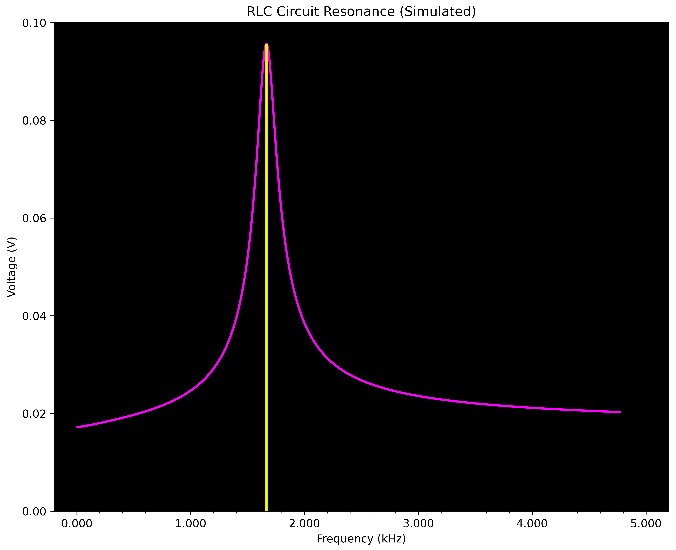
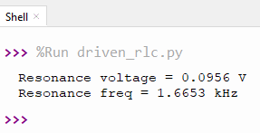
Our Revised Results
At resonance, the LC elements have nearly zero resistance, so the current (and hence voltage) flowing through R1 (and R2) would be at the maximum

Slide 15


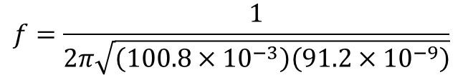


Checking Our Results
$$ω=\frac{1}{\sqrt{LC}}$$
$$f=\frac{1}{2π\sqrt{\left(100.8×{10}^{−3}\right)\left(91.2×{10}^{−9}\right)}}$$
$$f=\frac{ω}{2π}$$
$$f=\frac{16599 Hz}{1}×\frac{1 kHz}{1000 Hz}=1.6599 kHz$$
$$f=\frac{1}{2π\sqrt{LC}}$$
Euler's Method is only 1st order accurate and susceptible to stability issues with oscillating signals
😐

Slide 16
Team 08 – What We Learned
Inductors store electrical energy in a magnetic field
An inductor’s impedance is like a resistor’s resistance because they both oppose current flow in a circuit
Without a voltage source driving an RLC circuit, the initial energy will drain away due to heat loss in the resistor, but the circuit will still oscillate even while the voltage decays to zero
However, if an RLC circuit is continuously driven with a sinusoidal voltage source, there is a specific frequency at which the RLC circuit will resonate, meaning it will achieve the maximum possible voltage

